Slide 1
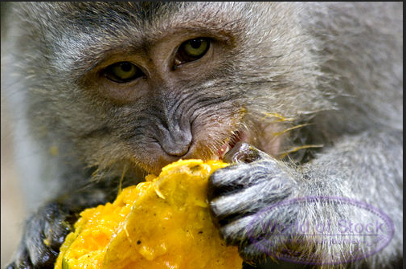
What’s for Lunch?
A Quadratic Application Problem
By Ms. Paris C/E block 1/29/14

Slide 2
The story…
A monkey named Marty was hungry for lunch. Seated on a branch 12 feet in the air, Marty spots a delicious mango on the tree next to him. He also notices a hungry Cougar named Charles circling the tree below him. Marty decides to make a jump for it and leap from his branch to the mango on the tree next to him. His height h in feet can be represented as a function of time t in seconds by the equation: h(t) = -5t²+12t+12.

Slide 3
Meet Marty!

Slide 4
Meet Charles!

Slide 5
The Questions h(t) = -5t²+12t+12.
At what time will Marty reach his maximum height in the air?
What is Marty’s maximum height in the air?
Charles the Cougar is just hoping Marty will miss the branch and hit the ground. If Marty hits the ground, and Charles is waiting for him (jaws open), at what time will Charles eat his monkey lunch?
If the mango is 10 feet off the ground, and Marty successfully completes his jump, at what time will Marty eat his Mango lunch?

Slide 6
At what time will Marty reach his maximum height in the air?
h(t) = -5t²+12t+12
t = -b/(2a)
=-12/[2(-5)]
=-12/-10
=1.2
Marty will reach is maximum height at 1.2 seconds.

Slide 7
What is Marty’s maximum height in the air?
h(t) = -5t²+12x+12
t=1.2
h(1.2) = -5(1.2)²+12(1.2)+12
h(1.2)= 14.4
Marty’s maximum height in the air is 14.4 feet.

Slide 8
Charles the Cougar is just hoping Marty will miss the branch and hit the ground. If Marty hits the ground, at what time will Charles eat his monkey lunch?
0= -5t²+12x+12
Quadratic Formula: t = -12±√[(12)² - 4(-5)(12)]
2(-5)
t= 3.16 or -0.76
Charles would eat his monkey lunch at 3.16 seconds

Slide 9
If the mango is 10 feet off the ground, and Marty successfully completes his jump, at what time will Marty reach his mango lunch?
10 = -5t²+12t+12
0 = -5t²+12t+2
Quadratic Formula: t= -12±√[(12)² - 4(-5)(2)]
2(-5)
t = 2.56 or -0.16
Marty would reach his mango lunch at 2.56 seconds

Slide 10
Parabola

Slide 11
The End!

